Slide 1

So you're moving to microservices
A guide to success and patterns that will save your butt

Slide 2








We are exceptional at:
ADVISORY SERVICES
APPLICATION DEVELOPMENT
MOBILE SOLUTIONS
DATA & ANALYTICS
We’re an IT solutions company that solves tough technology challenges so you can get back to business better than usual.
INTERNET OF THINGS
APPLICATION MANAGEMENT
TESTING SERVICES
PLATFORM SERVICES

Slide 3






About Me
I have been developing software commercially for the last 15 year. In my free time I enjoy mixing live music for local Louisville bands, making movies, and developing video games.
https://github.com/cdwaddell
https://www.linkedin.com/in/cdwaddell
@cdanielwaddell

Slide 4



Microservices… Go!

Slide 5
Notes:
Why switch to microservices?

Slide 6
Notes:
Overview of technologies

Slide 7
Notes:
Logging over view with correlation

Slide 8
Notes:
Micro APIs

Slide 9
Notes:
Demo of what it might look like to separate APIs

Slide 10
Notes:
APIs need to communicate

Slide 11
Notes:
Service bus

Slide 12
Notes:
Eventual consistency

Slide 13
Notes:
Message queing required read with acknowledgement

Slide 14
Notes:
Demo RabbitMQ/MSMQ At Least Once

Slide 15
Notes:
Read/Write issues with concurrency locks aka Availability vs Consistency

Slide 16
Notes:
Retry with exponential backoff

Slide 17
Notes:
Circuit Breaker

Slide 18
Notes:
Bulkhead Isolation

Slide 19
Notes:
Retry logic demo in asp.net core using Polly

Slide 20
Notes:
CQRS with Event Sourcing

Slide 21
Notes:
Retry logic with circuit breaker

Slide 22
Notes:
Demo of Jimmy Bogarts CQRS

Slide 23









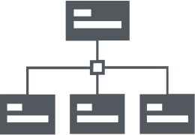




















Slide 24































Slide 25































Slide 26











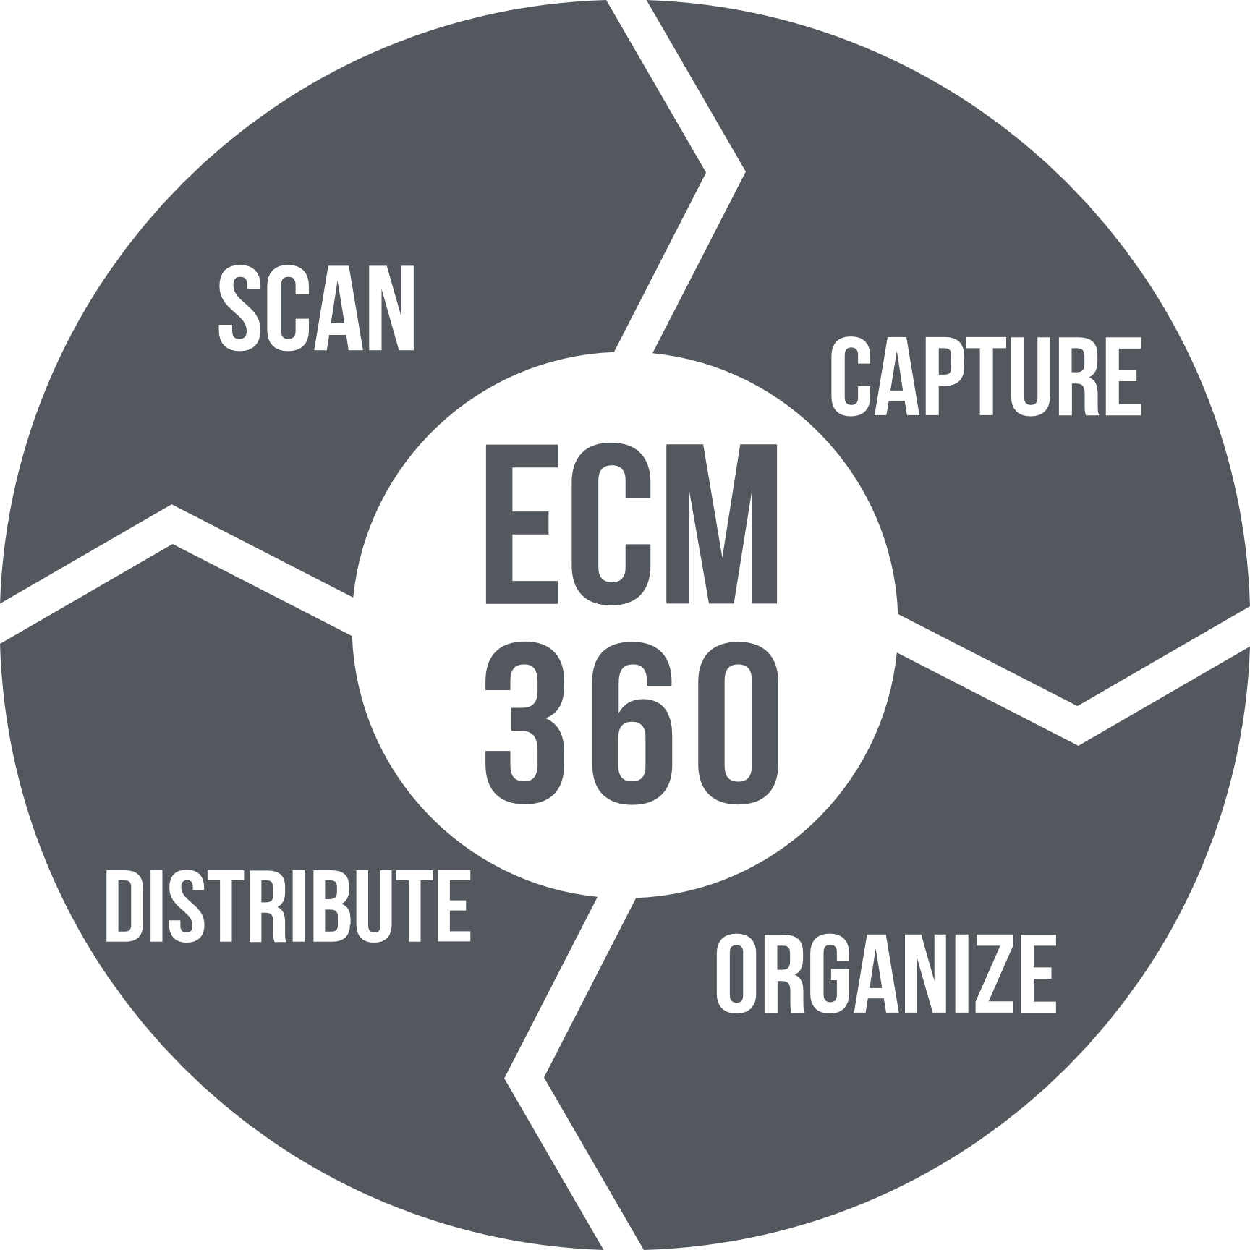
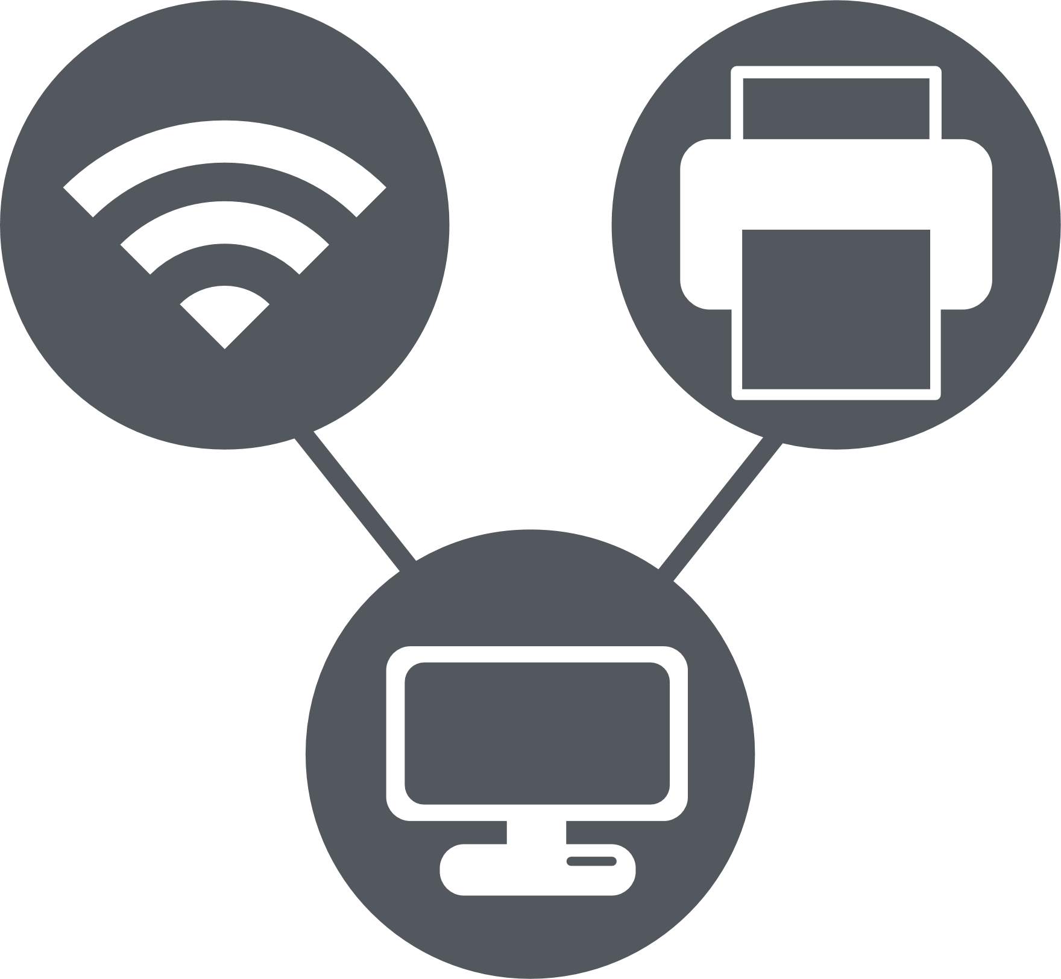

CIO
CMO
Developer
IT Manager
Content Manager
CIO
CMO
Developer
IT Manager
Content Manager
egrants
Enterprise
Content MGMT.
Managed Services
Technology Solutions

